Slide 1
DEVELOPING BUSINESS APPLICATIONS USING GEN-AI (BIA 810-A)
FINAL PROJECT
AI-POWERED FITNESS TRACKER AND HEALTH MONITORING BOT
Empowering users with actionable health insights through AI-driven analytics.
ARUN KASHYAP
CWID: 20022803
M.S Data Science
Stevens Institute of Technology
Fall 2024
NIRANJAN REDDY SADULA
CWID: 20025413
M.S. Machine Learning
Stevens Institute of Technology
Fall 2024
SAI HARSHITH REDDY BONDUGULA
CWID: 20027869
M.S. BIA
Stevens Institute of Technology
Fall 2024

Slide 2
INTRODUCTION
PROBLEM STATEMENT:
With the rise in wearable health devices and growing health concerns, People face challenges interpreting complex wearable health data and make informed decisions.
Our bot bridges this gap by transforming raw data into meaningful insights
OBJECTIVES:
Simplify health data analysis for end-users.
Provide actionable insights and tailored recommendations.
Enable dynamic visualizations of health metrics.
Leverage AI to ensure a smooth and intuitive experience.
Notes:
“In this project, we aim to tackle a real-world challenge of analyzing and interpreting health data effectively. By combining AI, generative models like Claude, and a user-friendly interface, the bot provides users with intuitive insights, actionable advice, and visualizations to improve their health management experience. It is an all-in-one solution accessible through platforms like streamlit, ensuring ease of use.”

Slide 3
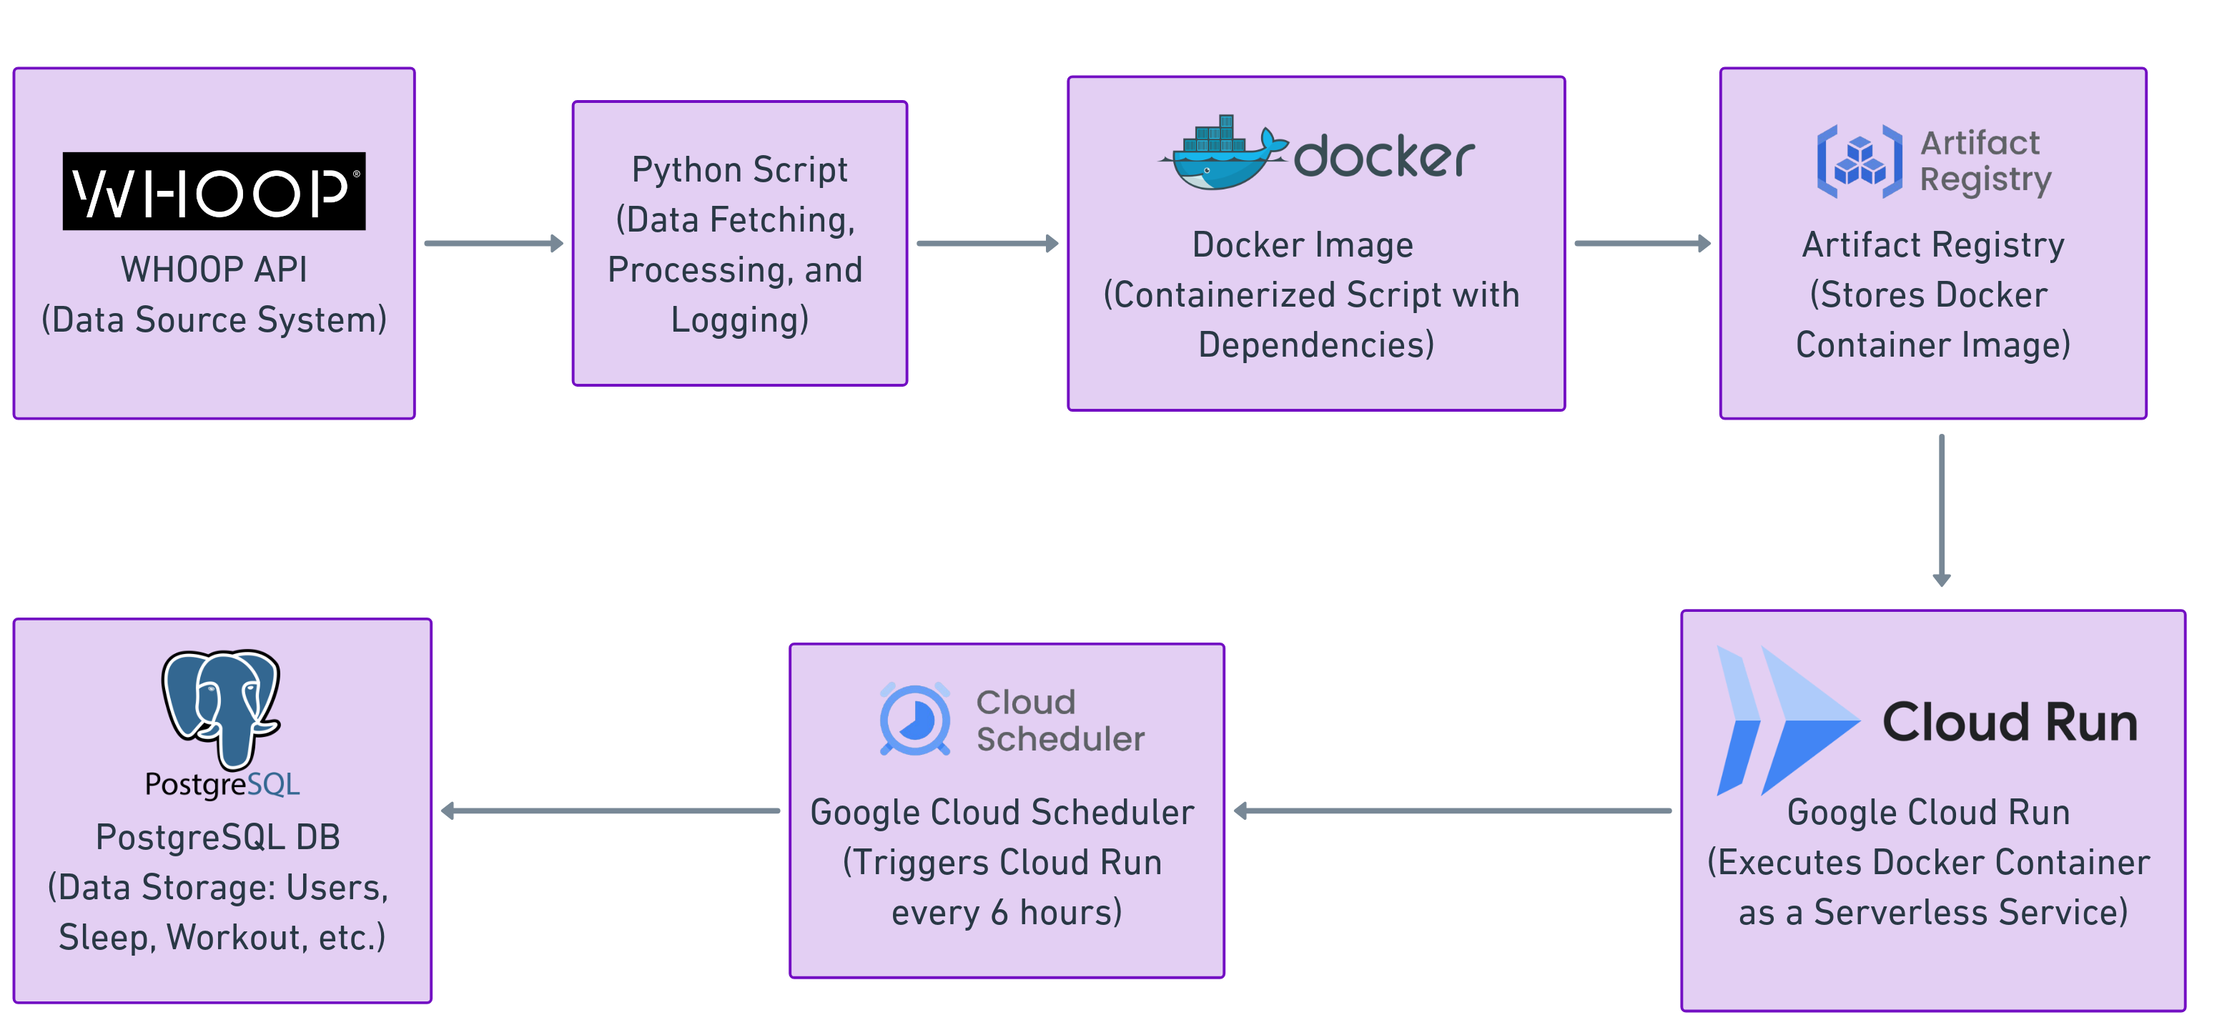
DATA PIPELINE
Notes:
This is the data pipeline that powers our AI Health Monitoring Bot. It begins with data ingestion from WHOOP's API, which is processed using a Python script. The script is containerized using Docker for portability and stored in Artifact Registry. Google Cloud Run executes the container as a serverless service, triggered every 6 hours by Google Cloud Scheduler. The final processed data is stored in a PostgreSQL database for further insights generation and visualizations.

Slide 4
DATA PIPELINE
WHOOP DATA FETCH AND STORAGE:
API Authorization: Secure connection to WHOOP API using OAuth2 credentials.
Data Retrieval: Fetch data through specific endpoints: Profile, Body Measurements, Cycle, Recovery, Sleep, and Workout.
Data Storage: Store fetched data into corresponding PostgreSQL tables.
Logging: Record execution details for monitoring and debugging.
Error Handling: Manage API failures and database errors for reliable execution.
Deployment: Deploy as a Flask API hosted on Google Cloud Run for scalability and accessibility.
Notes:
“These steps summarize the script's functionality, starting with secure API authorization, fetching relevant health metrics, and storing them in PostgreSQL. Logging and error handling ensure smooth execution, while deployment on Google Cloud Run makes the service scalable and accessible.”

Slide 5
DATABASE DESIGN AND STORAGE
DATABASE PLATFORM:
Google Cloud SQL is used for hosting the database.
PostgreSQL is the database system chosen for structured and efficient data management.
TABLE STRUCTURE:
Data is stored in normalized tables for clarity and efficient querying.
Key tables include:
users: Stores user details (user_id, first_name, last_name, email).
sleep_data: Sleep metrics (total sleep time, REM sleep, deep sleep, efficiency).
recovery_data: Recovery scores, resting heart rate, and HRV (Heart Rate Variability).
workout_data: Detailed workout data (distance, strain, kilojoules).
body_measurements: User body stats (height, weight, max heart rate).

Slide 6
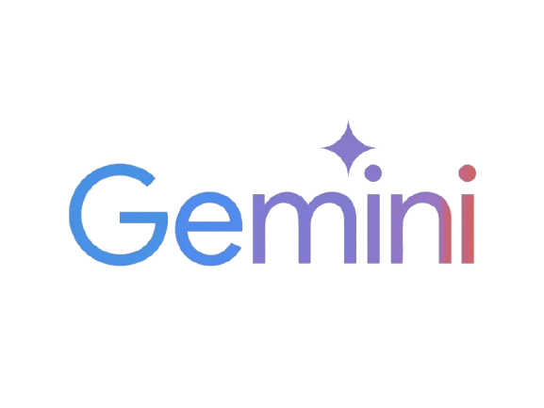
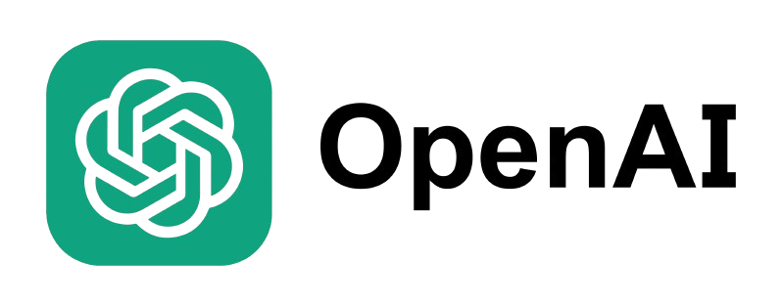
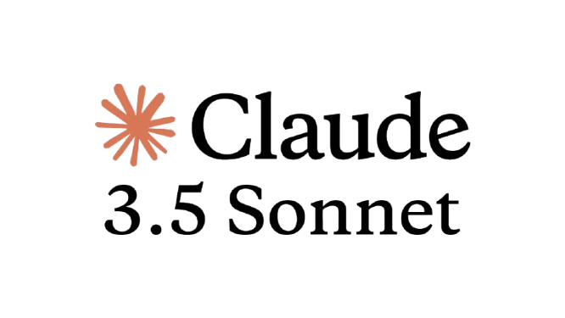
COMPARISON OF LLMs USED
MODEL | PROS | CONS | FINAL VERDICT
Gemini (Google) 1.5 Pro | Free API availability. | Failed in SQL query generation, especially for complex prompts. | Did not meet requirements.
 | Able to generate basic insights for provided data. | Not suitable for dynamic code generation.
OpenAI GPT-4 | Performed well in generating SQL queries, including tricky prompts. | Struggled with Python code generation for visualizations. | Partially met requirements.
 | Good at generating insights and recommendations. | Required manual fixes to complete workflows.
Claude 3.5 Sonnet | Outstanding in SQL query generation for complex data retrieval. |  | Best choice – Chosen model.
 | Generated accurate and dynamic Python visualizations. | Less than 2% failure rate in Python code generation for visualizations.
 | Delivered high-quality insights and recommendations.

Slide 7
CHATBOT ENGINE
USER INTERACTION AND QUERY PROCESSING
User Interaction:
The user inputs natural language queries such as:
"What is my average sleep time?“
"Show me my top 5 heart rates recorded.“
Query Processing:
The Claude AI (Claude 3.5 Sonnet) API processes the user input to:
Generate accurate SQL queries to retrieve health metrics from the database.
Handle context-specific queries intelligently.

Slide 8
CHATBOT ENGINE
DATA RETRIEVAL AND INSIGHT GENERATION
Data Workflow:
SQL Query Execution:
The generated SQL query fetches relevant data from the PostgreSQL database.
Insight Generation:
The fetched data is analyzed using Claude AI to generate:
Summarized trends
Actionable insights (e.g., "You had more deep sleep this week").
Tailored Suggestions:
Based on the insights, the chatbot provides actionable health recommendations:
Example: "Maintain consistent sleep timings to improve sleep efficiency."

Slide 9
CHATBOT ENGINE
DYNAMIC VISUALIZATIONS
Automated Visualization Generation:
Health metrics are visualized dynamically using Matplotlib for better data interpretation.
Examples include:
Bar Charts for comparing heart rates or sleep efficiency.
Line Charts to observe trends in recovery scores or workout performance.
Customizable Visualizations:
Users can specify their desired visualization type (e.g., bar, line, scatter plots).
The AI adapts and generates Python code for accurate visual output.
Enhanced User Experience:
Charts are presented seamlessly in the chatbot interface.
Visual trends simplify complex health data into actionable insights.

Slide 10
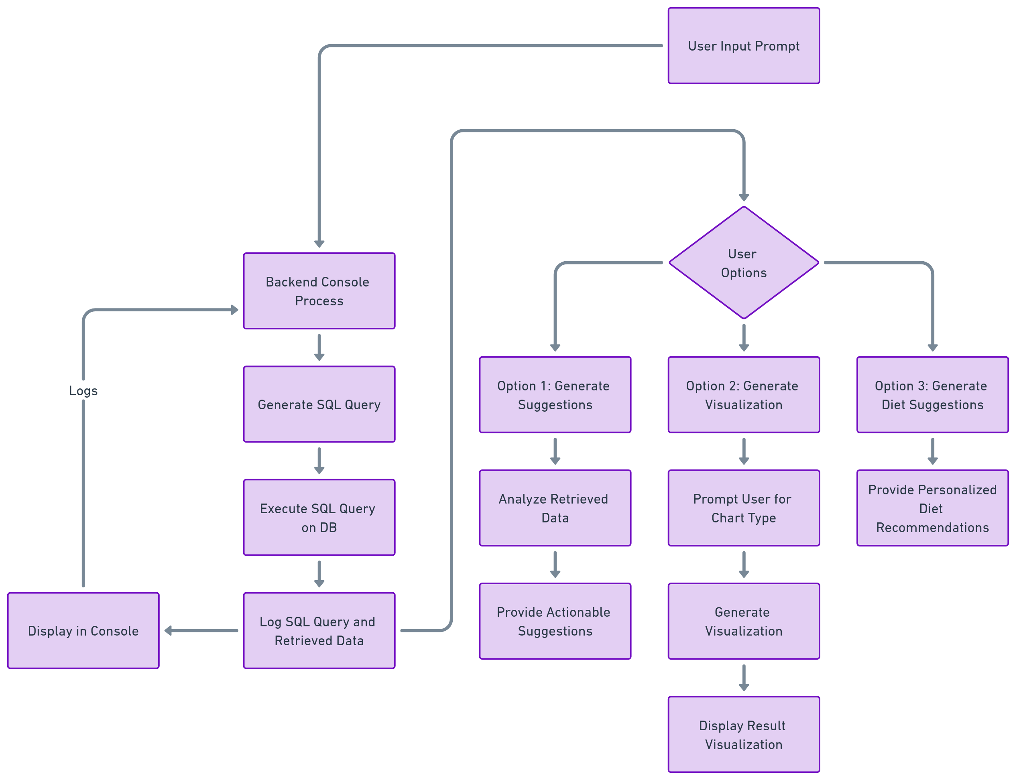
SYSTEM FLOW

Slide 11
EXAMPLES
PROMPT: “how my active days influenced my heart rate this month provide me top 5 results with distinct days”
Generate SQL Query is:
SELECT DISTINCT ON (DATE(cd.created_at))
DATE(cd.created_at) AS date,
cd.strain AS daily_strain,
cd.average_heart_rate,
cd.max_heart_rate,
rd.resting_heart_rate
FROM cycle_data cd
JOIN recovery_data rd ON cd.user_id = rd.user_id AND DATE(cd.created_at) = DATE(rd.created_at)
WHERE cd.user_id = 21406427
AND cd.created_at >= DATE_TRUNC('month', CURRENT_DATE)
AND cd.created_at < DATE_TRUNC('month', CURRENT_DATE) + INTERVAL '1 month'
ORDER BY DATE(cd.created_at), cd.strain DESC
LIMIT 5;

Slide 12
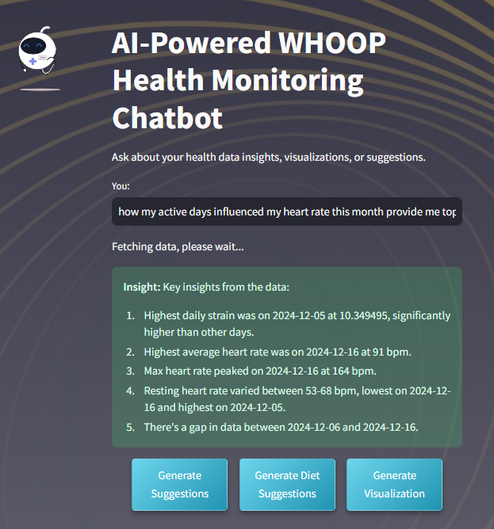
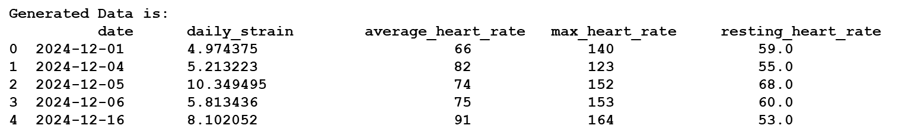
GENERATING INSIGHTS

Slide 13
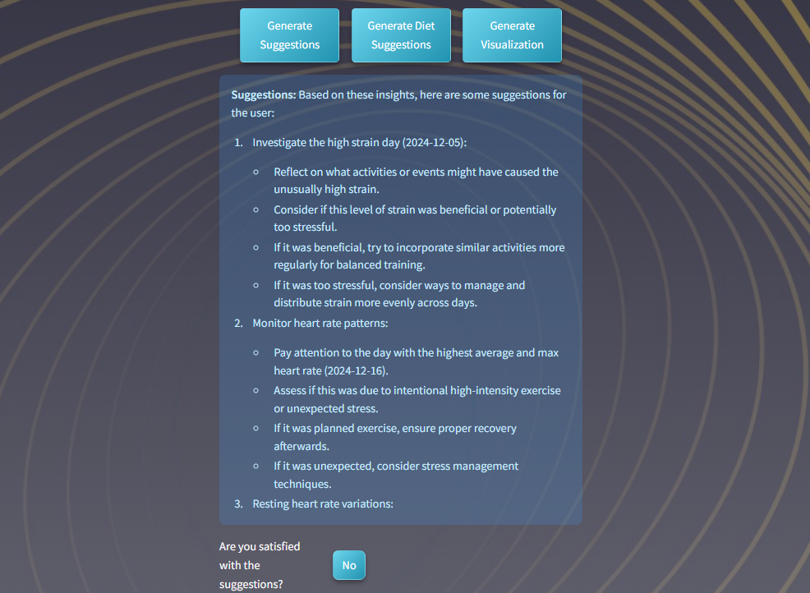
GENERATING SUGGESTIONS

Slide 14
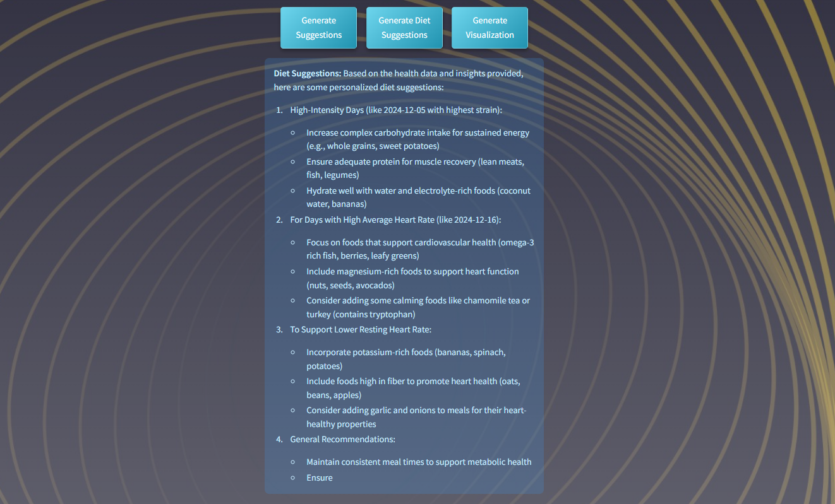
GENERATING DIET SUGGESTIONS

Slide 15
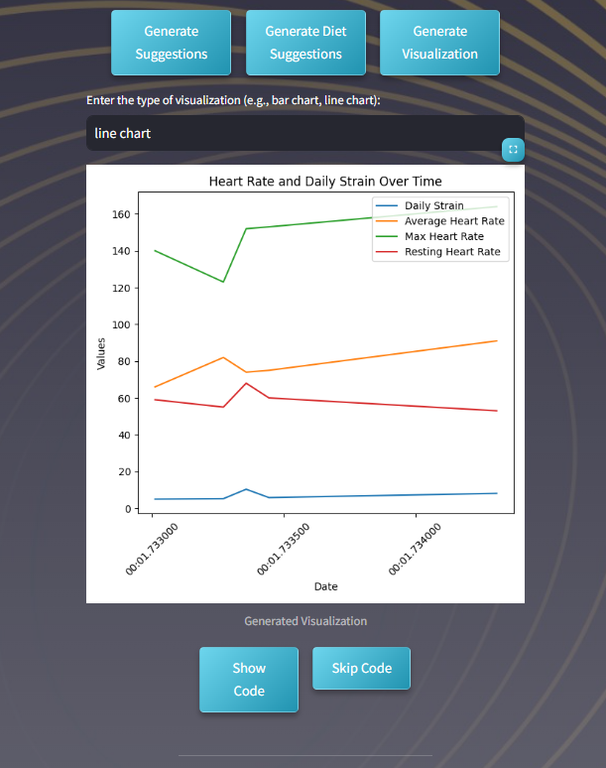
GENERATING VISUALIZATIONS
Generated Visualization Code:
import matplotlib.pyplot as plt
import pandas as pd
# Convert date to datetime
data['date'] = pd.to_datetime(data['date'], unit='s')
# Create the line chart
plt.figure(figsize=(6, 6))
plt.plot(data['date'], data['daily_strain'], label='Daily Strain')
plt.plot(data['date'], data['average_heart_rate'], label='Avg Heart Rate')
plt.plot(data['date'], data['max_heart_rate'], label='Max Heart Rate')
plt.plot(data['date'], data['resting_heart_rate'], label='Resting Heart Rate')
plt.xlabel('Date')
plt.ylabel('Value')
plt.title('Heart Rate and Daily Strain Over Time')
plt.legend()
plt.xticks(rotation=45)
plt.tight_layout()
# Save the plot
plt.savefig(r'D:\GenAI_Project\health_chatbot_project\visualizations\visualization.png')
File successfully created: D:\GenAI_Project\health_chatbot_project\visualizations\visualization.png

Slide 16
DEMO

Slide 17
CONCLUSION
OBJECTIVES ACHIEVED:
Simplified complex health data into meaningful insights.
Delivered personalized suggestions, visualizations, and diet recommendations.
KEY FEATURES:
Dynamic SQL query generation.AI-powered insights and visualizations.
User-friendly chatbot interface with interactive options.
IMPACT:
Enabled actionable insights for improved decision-making.
Enhanced user engagement through tailored responses.

Slide 18
FUTURE ENHANCEMENTS
Adding support for additional health APIs (e.g., Apple Health, Fitbit).
Improving chatbot capabilities with multimodal features (voice input, image recognition).
Expanding visualization options with interactive dashboards.
Incorporating predictive analytics for health forecasts.
Enhancing dietary suggestions using nutrition databases and AI.

Slide 19
THANK YOU

